Slide 1
CARBON FOOTPRINT CALULATOR AND A STEP TOWARDS CARBON FREE CITY
BY
NATHAN.YAKOB.WAGHCHOURE

Slide 2
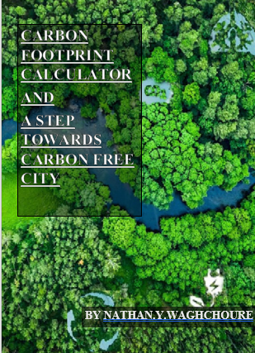
THIS IS MY DOCUMENTATION AS YOU CAN SEE

Slide 3
WHAT IS CARBON FOOTPRINT?
A carbon footprint is the total amount of greenhouse gases (including carbon dioxide and methane) that are generated by our actions.
The average carbon footprint for a person in the United States is 16 tons, one of the highest rates in the world. Globally, the average carbon footprint is closer to 4 tons. To have the best chance of avoiding a 2℃ rise in global temperatures, the average global carbon footprint per year needs to drop to under 2 tons by 2050.
Lowering individual carbon footprints from 16 tons to 2 tons doesn’t happen overnight! By making small changes to our actions, like eating less meat, taking fewer connecting flights and line drying our clothes, we can start making a big difference.

Slide 4
carbon footprint, amount of carbon dioxide (CO2) emissions associated with all the activities of a person or other entity (e.g., building, corporation, country, etc.). It includes direct emissions, such as those that result from fossil-fuel combustion in manufacturing, heating, and transportation, as well as emissions required to produce the electricity associated with goods and services consumed. In addition, the carbon footprint concept also often includes the emissions of other greenhouse gases, such as methane, nitrous oxide, or chlorofluorocarbons (CFCs).

Slide 5
SOURCES OF CARBON FOOTPRINT
Internal Combustion Engines
Fossil Fuels And Coal
Petroleum
Mining
Factories
Fertilisers
Pesticides & Insecticides
Power Lines

Slide 6
PURPOSE OF THIS PROJECT
Heal the environment by reducing the amount of greenhouse gases that are released into the atmosphere ¹.
Stop wildlife extinction by preserving specific weather patterns and vegetation ¹.
Reduce health risks by mitigating climate change and its impacts ².
Improve local economies by creating new economic opportunities, such as jobs in developing and deploying carbon removal technologies

Slide 7
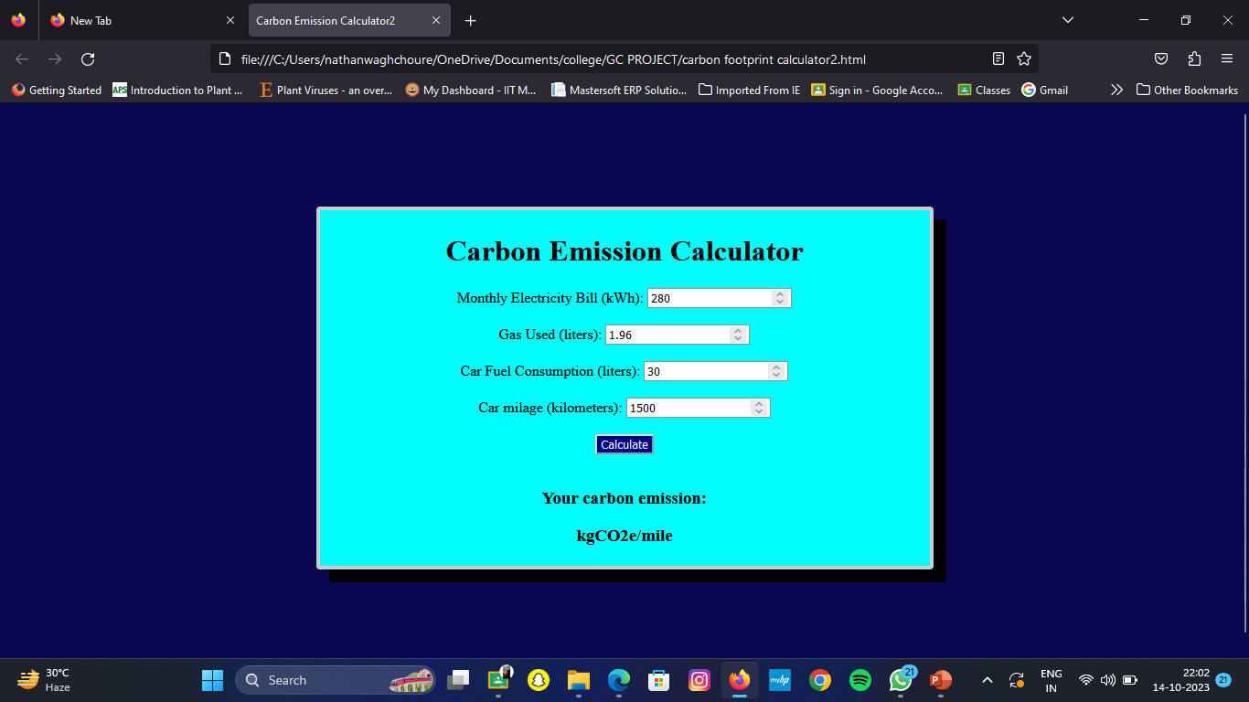
CARBON FOOTPRINT CALCULATOR

Slide 8
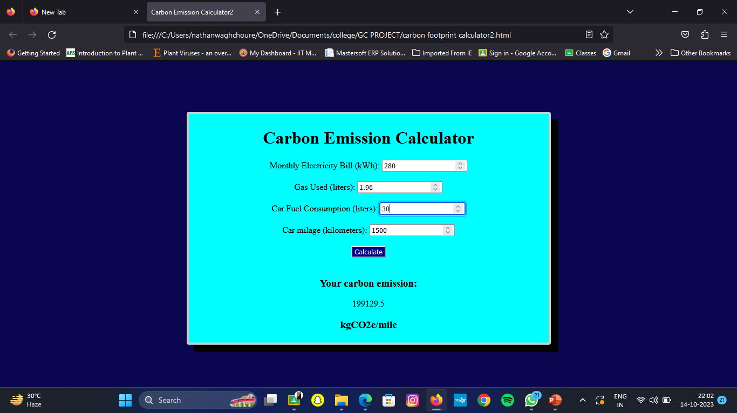

Slide 9
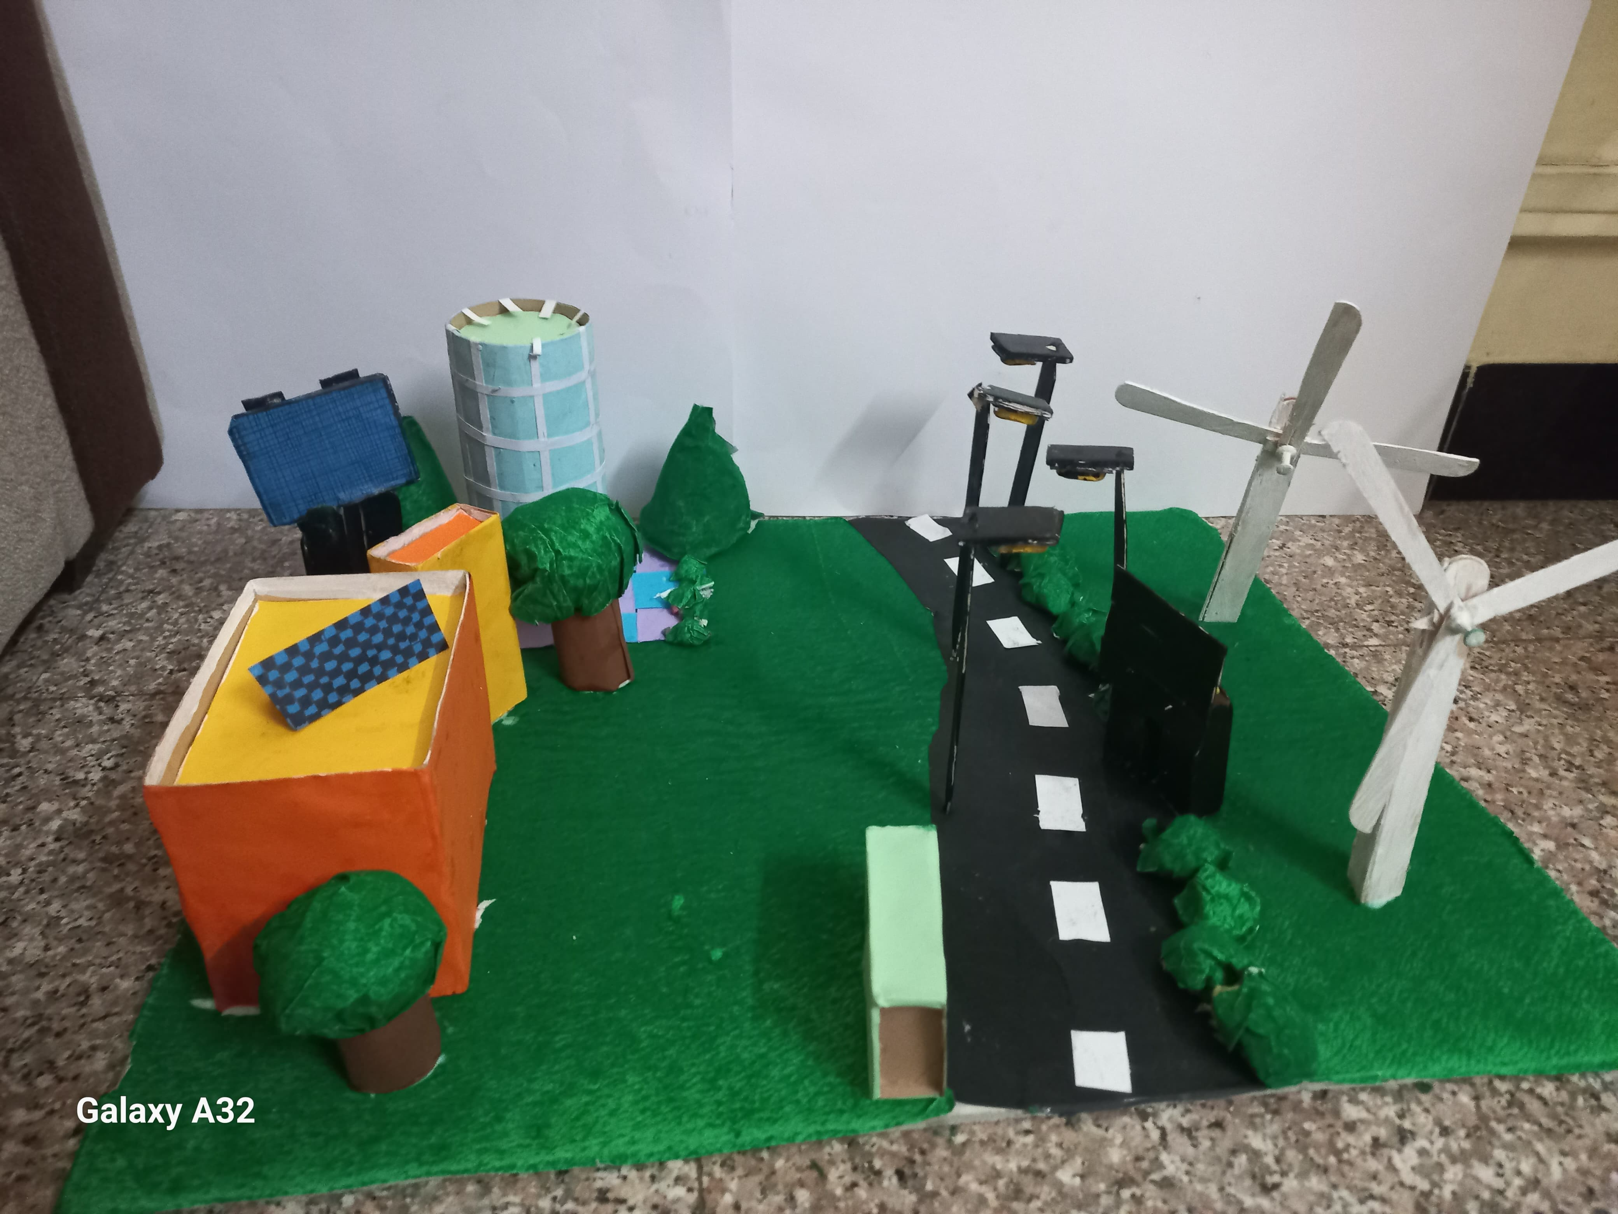
CARBON FREE CITY

Slide 13
CONCLUSION

